Slide 1
Care and Treatment Reviews
&
The Care Programme Approach

Slide 2
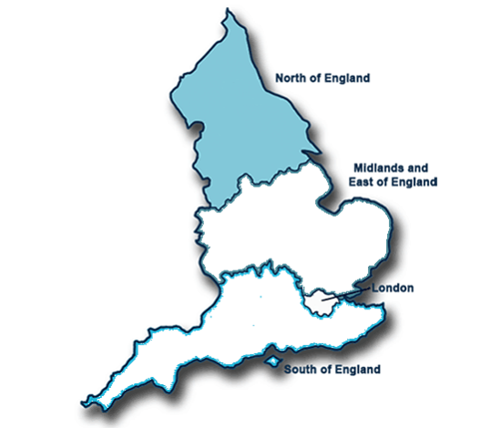
Aims
I tried to see how well the Care Programme Approach (CPA) and Care and Treatment Reviews (CTRs) are working in the north of England.

Slide 3
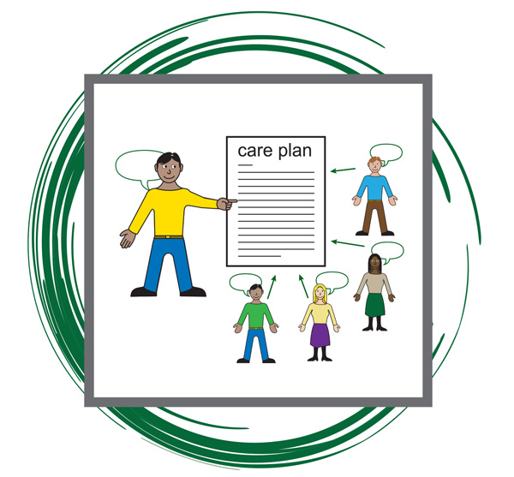
What is the Care Programme Approach
It is a way of making sure people get the right health and social care.
It’s about keeping people safe.
It includes:
Finding out what people need
Making a plan that says who will do what to meet people’s needs
Having a ‘care coordinator’ who helps make sure the plan is happening
Holding regular review meetings to check the plan is working
For some people it may be part of their Health Action Plan

Slide 4

What are care and treatment reviews
Care and Treatment Reviews were introduced in 2014. They make sure people are getting the right help in the right place.
Reviews are done by people who are not part of the hospital – this means they are independent.
They check:
Is the person safe?
Is the person getting good care now?
What are their plans for the future?
Can care and treatment be provided in the community?
People who use services and their families are listened to.
The review team meets people involved in the person’s care and makes recommendations.

Slide 5


What is CPA+
CPA+ is something that has been tried in the North.
It is where the Care Programme Approach and Care and Treatment Reviews are combined.
This usually means when the Care and Treatment Review finishes, the panel go to a Care Programme Approach review.

Slide 6

What did I do?
2 Projects for NHS England:
I visited 15 services. Some were in Yorkshire, others in the North West, and some in the North East.
I looked at reports from CPA meetings and CTR meetings.
I read policies.
I watched CPA meetings, CTRs and CPA+ meetings
I talked to staff
I talked to people on CTR panels
I talked to commissioners
I talked with people who use services, families and advocates
I did a survey of people who have been to CPA+ meetings

Slide 7
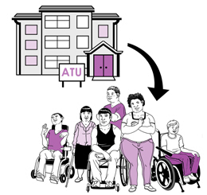
Where were the people?
Everyone was living in hospital.
Some people were in locked units because they had committed serious crimes and the court thought they were very dangerous.
Other people had lots of treatments but were still in locked units because people thought they were still too dangerous to be discharged and live in their own homes.

Slide 8

Where were the people?
Different areas have different numbers and types of unit and beds:
  The North West has less beds than the other areas.
  But the North West has more people in locked units.
The North West uses more NHS services than Yorkshire but less than the North East

Slide 9



How long had people been there?
People with learning disabilities spend a lot longer in locked units than people who don’t have a learning disability.
People in the north spend longer in locked units than those in other areas of the country
In the North people are more likely to be in units with lots of locks and fences.
On average people had been in locked units for more than 5 years.
In the north of England, people in locked units tend to be a bit older than people in the rest of the country
Many more men than women are in these units.

Slide 10

Why had people been locked up?
I mainly looked at people who had committed crimes.
Some people in these units have not committed crimes
4 out of 10 people were in locked units because they had sexually assaulted a child
3 out of 10 people were in hospital because they had committed a violent crime
2 out of 10 people were in hospital because they had set a fire
People who had sexually assaulted a child had been in hospital the longest
People who committed violent crimes were likely to get out sooner

Slide 11


Were people making good progress?
Only 1 in 3 people are near to being discharged.
BUT this is more than it was 3 years ago.
People who have completed lots of courses related to their offence were more likely to be making progress
People who are considered by the hospital to be dangerous are making least progress
People in NHS units are more likely to be near to being discharged

Slide 12
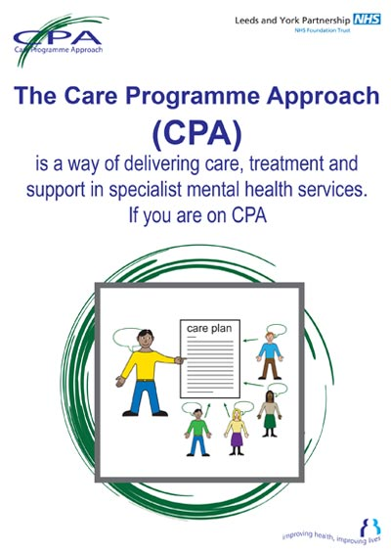


How is CPA working?
CPA is sometimes not done very well
CPA is poorly understood
Some important people don’t go to CPA meetings
CPA is often not linked to Health Action Plans
There were a few examples of really good person centred CPA meetings

Slide 13


How are CTRs working?
CTRs are valued by people and their families
CTRs have led to some people being discharged quicker
CTRs have led to some people getting quicker access to the right care
Independent experts in CTRs is the thing that makes the difference
When CTRs started they were poorly recorded but this has improved
Sometimes CTR recommendations have not been acted on – but this seems to be getting better
CTRs cost a lot of money – some people think that this might be a problem in future
CTRs work best where the teams have the right skills – sometimes this is difficult

Slide 14


What about CPA+
CPA+ means that people have less meetings to worry about
CPA+ is more person centred than CPA on its own
CPA+ means that CTR recommendations are more likely to be acted on
CPA+ meetings are usually attended by all the right people
CPA+ doesn’t fix all the problems with CPA
CPA+ meetings are very difficult to organise
CPA+ sometimes means a shorter CTR

Slide 15

What needs to happen?
We need new guidelines on CPA
We need to make sure that CPA care coordinators have the right skills
Commissioners need to go to CPA meetings
We should share examples of good practice
We need to be better at sharing CTR recommendations with people and families
CTR recommendations need to be built into CPA care plans

Slide 16
What needs to happen?
CTR recommendations need to be acted on
Staff in services need training to understand CTRs
CTRs should continue after a person has been discharged
CTR panels should check to see if CPA is being done properly
For now, we should continue to use CPA+
CPA+ meetings should not be rushed
We need to do more work to understand local areas

