Slide 1
Getting the right care in the right place
Care and Treatment Reviews
April 2016

Slide 2


Thankyou for inviting us today
Anne Webster
Carl Shaw
NHS England Learning Disability Programme

Slide 3

Overview
Care and Treatment Reviews
Why do they matter?
Where do they fit in to the Learning Disability Programme?
What are they all about?
‘The spirit in which CTRs are carried out is paramount and is rooted in principles of human rights, person-centeredness and co-production.’

Slide 4



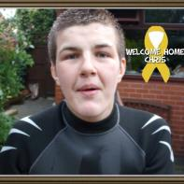
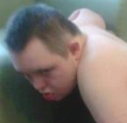

This week – 7 Days of Action
Eden
Chris
Thomas
Tianze
Notes:
Top left Eden
topright Chris
Bottom right – Tianze
Bottom left - Thomas

Slide 5
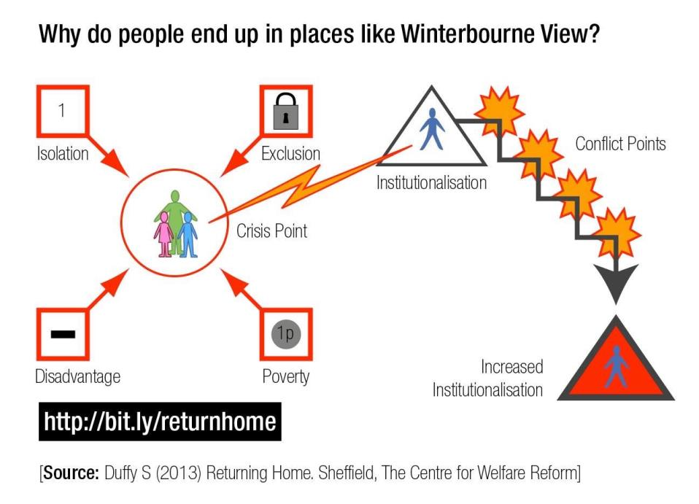
Notes:
Seven days of action this week- very relevant- powerful stories experiences- please all read- this should drive people forwards- promoting good work you do and challenging oneself

Slide 6
CTRs are part of the Learning Disability Programme
Building the Right Support:
Reduce the number of people in learning disability and mental health hospitals
Reduce how long people stay in these hospitals
Improve the quality of care and support for people in both hospital and the community
Improving the Health & Health Outcomes for people with Learning Disabilities:
Quality assurance approach to improving access to health and improve health outcomes eg. annual health checks, premature mortality work and stopping over-medication.
Notes:
DH NHS E ADASS LGA CQC HEE

Slide 7
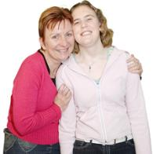
Programme Principles
Support for my family and paid staff
Short breaks and accommodation Trained support and care staff
A good and meaningful life
Inclusion,
education, employment, relationships, support
Where I live and who I live with
Choice of housing
Secure tenancies
Housing planning
Money, early intervention, advocacy, support plans
People and families at the centre
Good mental health hospital care
Integrated with good community services
Care & Treatment Reviews
Discharge planning
Good mainstream
health services
Annual Health Checks
Health action plans
Health passports
Liaison workers
Quality checkers
Reasonable adjustments
Specialist health and social care support
24/7 function
Forensic support
Inter-agency work
Liaison and diversion

Slide 8
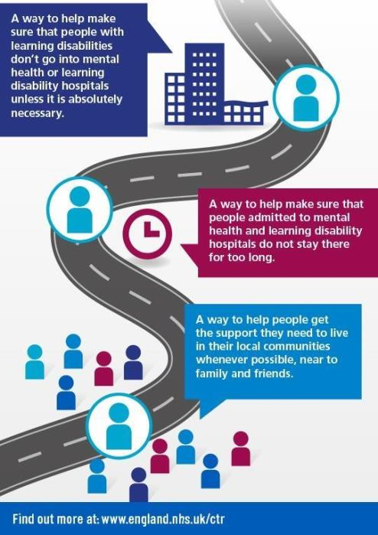
What is a
Care and Treatment Review?

Slide 9
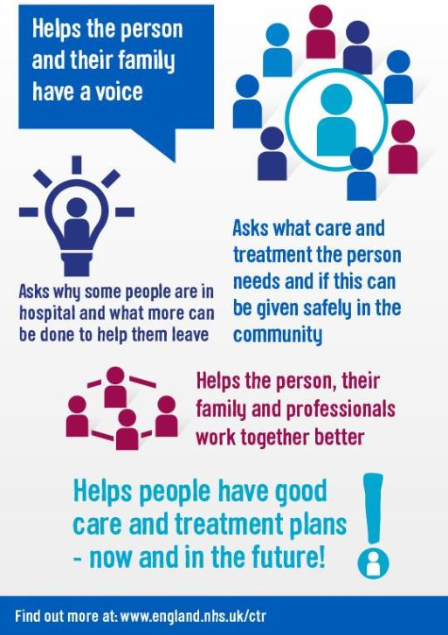
What does a CTR do?

Slide 10
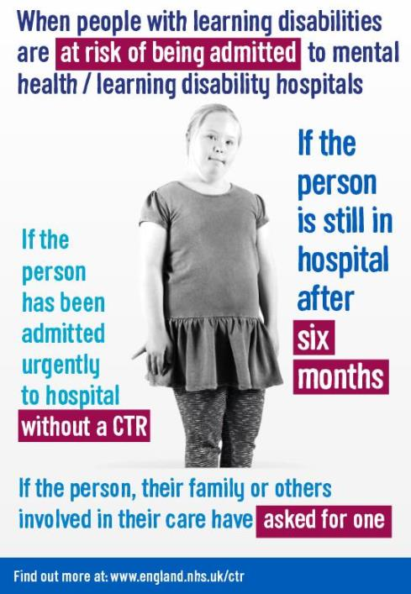
When do Care and Treatment Reviews happen?

Slide 11
Four Big Questions
Am I Safe?
What’s My Current Care Like?
Is there a plan in place for my future?
Does my care & treatment need to take place in hospital?

Slide 12
How is a CTR carried out?
A team of people called a CTR panel carry out the reviews
The panel is led by the person’s commissioner
It also includes two expert advisers, one is a clinical adviser. The other is an expert by experience
They work with the commissioner, meeting the person being reviewed and all the people involved in the person’s current and future care
They find out about the person’s care and check they are safe & ask what plans are in place for their future.
They produce recommendations to improve the person’s care now and in the future

Slide 13
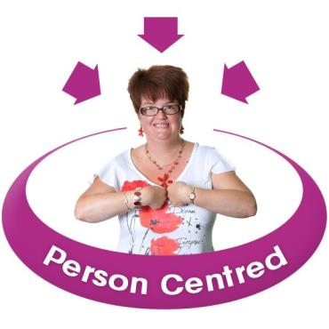
Empowering and involving people
The CTR puts the person with a learning disability at the centre of the process
It is about the person’s experience of care, their hopes and ideas for how it can get better
It responds to the views of family carers, if the person wants this
It helps people challenge the care they are receiving and future plans
It supports people to raise concerns or make a complaint

Slide 14

Facts and figures
In the last year, about 3600 CTRs have take place
1,900 people discharged from hospital or transferred
The number of people in hospital has fallen to about 2,600
This number is still too high

Slide 15
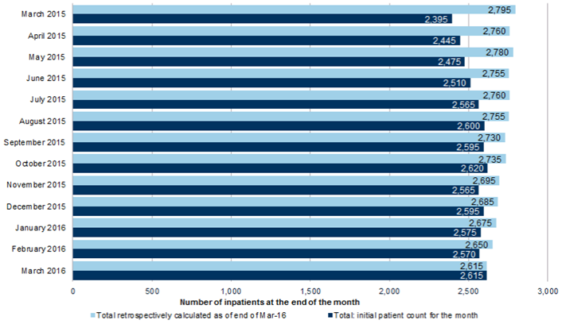
Number of people in hospital

Slide 16

Working together
Being creative & open minded
Problem solving
Listening to people & families.
Agreeing actions and who will do what by when
  What makes a successful CTR?
Notes:
DH NHS E ADASS LGA CQC HEE

Slide 17

Learning and improving
Audits
Assurance Framework
Professions & providers
Relationship with CPA
E-learning package
Expert by Experience Hubs
Review of Policy October 2016
Other resources
Notes:
66 CTRs
CTRs themselves have clearly been highlighting:
deficiencies in services provided and available
deficiencies in treatment
a lack of clarity around the rationale for admission and / or for continued hospital stay
deficiencies in person-centred specification work
lack of involvement of people in their own treatment pathways and engaging families as partners
Difficulties in obtaining detailed national data
How to match stats with fundamental objectives

Slide 18

NHS England website www.england.nhs.uk/learningdisabilities
For more information about
Care and Treatment Reviews
Transforming Care
Building the Right Support
Improving health and reducing inequalities
Resources

Slide 19
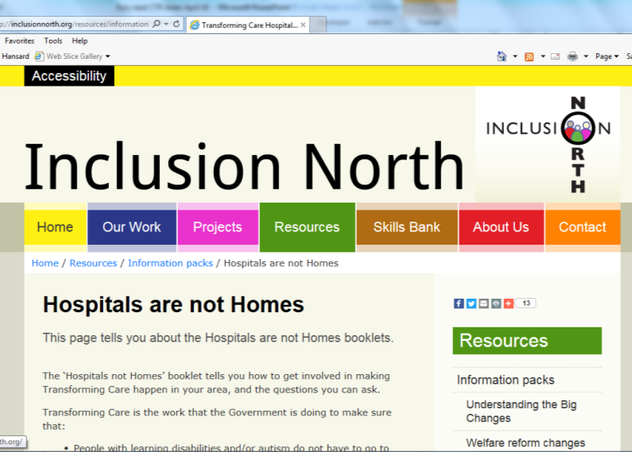
www.inclusion.org

Slide 20
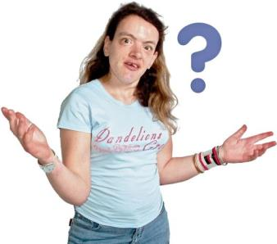
Thank you for listening
Any Questions?

